Slide 1
Chapter 10 Gases
Chapter 11 Liquids and Intermolecular Forces

Slide 2
1. Which of the following statements about gases is false? __________
A) Gases are highly compressible.
B) Distances between molecules of gas are very large compared to bond distances within molecules.
C) Non-reacting gas mixtures are homogeneous.
D) Gases expand spontaneously to fill the container they are placed in.
E) All gases are colorless and odorless at room temperature.
E

Slide 3
2. Which of the following equations shows an incorrect relationship between pressures given in terms of different units? __________
A) 1.20 atm = 122 kPa
B) 152 mm Hg = 2.03 × 10⁴ Pa
C) 0.760 atm = 578 mm Hg
D) 1.0 torr = 2.00 mm Hg
E) 1.00 atm = 760 torr
D

Slide 4
3. Sodium bicarbonate is reacted with concentrated hydrochloric acid at 37.0 ºC and 1.00 atm. The reaction of 6.00 kg of bicarbonate with excess hydrochloric acid under these conditions will produce ________ L of CO₂.
A) 1.09 × 10²
B) 2.85 × 10⁴
C) 1.82 × 10⁴
D) 8.70 × 10²
E) 1.82 × 10³
E
NaHCO₃ + HCl NaCl + H₂O + CO₂
n = 6000/84.1 = 71.34 mol
PV= nRT
1.01 kPa * V = 71.34 mol * 8.31 （kPa• dm³ •mol⁻¹ •K⁻¹）* （273+37） K
V = 181989 dm³ = 181.989 m³

Slide 5
4. The kinetic-molecular theory predicts that pressure rises as the temperature of a gas increases because ________.
A) the average kinetic energy of the gas molecules decreases
B) the gas molecules collide more frequently with the wall
C) the gas molecules collide less frequently with the wall
D) the gas molecules collide more energetically with the wall
E) both the gas molecules collide more frequently with the wall and the gas molecules collide more energetically with the wall
E

Slide 6
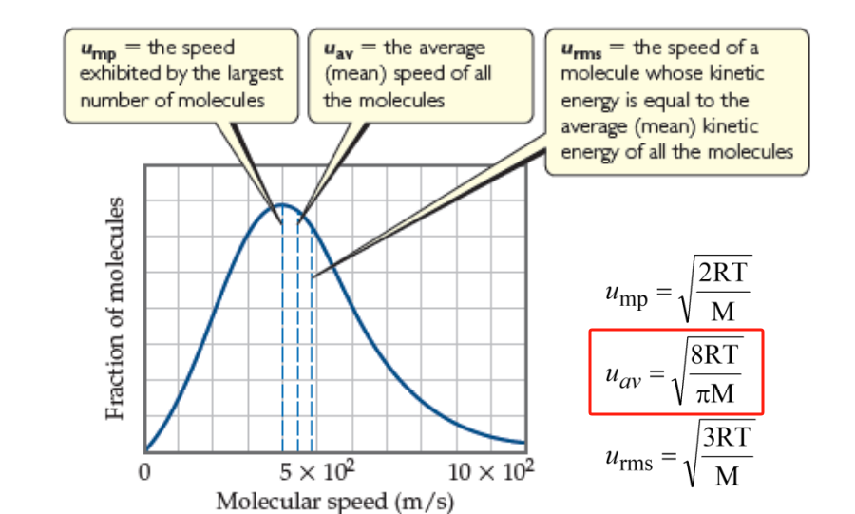
5. Arrange the following gases in order of increasing average molecular speed at 25 ºC. ________
He, O₂, CO₂, N₂
A) He < N₂ < O₂ < CO₂
B) He < O₂ < N₂ < CO₂
C) CO₂ < O₂ < N₂ < He
D) CO₂ < N₂ < O₂ < He
E) CO₂ < He < N₂ < O₂
C
M(CO₂) ＞ M(O₂) ＞ M(N₂) ＞ M(He)

Slide 7
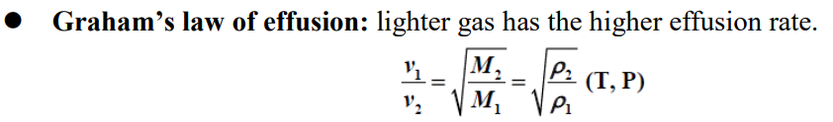

6. A mixture of two gases was allowed to effuse from a container. One of the gases escaped from the container 1.43 times as fast as the other one. The two gases could have been ________.
A) CO and SF₆
B) O₂ and Cl₂
C) CO and CO₂
D) Cl₂ and SF₆
E) O₂ and SF₆
D
$\frac{V1}{V2}$ = 1.43 = $\sqrt{\frac{M2}{M1}}$
$\frac{M2}{M1}$= 2.04
M (SF6)= 146.05
M (Cl2)= 70
M (CO)= 28
M (CO2)= 44

Slide 8
7. A real gas will behave most like an ideal gas under conditions of ________.
A) high temperature and high pressure
B) high temperature and low pressure
C) low temperature and high pressure
D) low temperature and low pressure
E) STP
B

Slide 9
8. The van der Waals equation for real gases recognizes that ________.
A) gas particles have non-zero volumes and interact with each other
B) molar volumes of gases of different types are different
C) the non-zero volumes of gas particles effectively decrease the amount of "empty space" between them
D) the molecular attractions between particles of gas decreases the pressure exerted by the gas
E) all of the above statements are true
E

Slide 10
9. In liquids, the attractive intermolecular forces are ________.
A) very weak compared with kinetic energies of the molecules
B) strong enough to hold molecules relatively close together
C) strong enough to keep the molecules confined to vibrating about their fixed lattice points
D) not strong enough to keep molecules from moving past each other
E) strong enough to hold molecules relatively close together but not strong enough to keep molecules from moving past each other
E

Slide 11
10. The strongest interparticle attractions exist between particles of a ________, and the weakest interparticle attractions exist between particles of a ________.
A) solid, liquid
B) solid, gas
C) liquid, gas
D) liquid, solid
E) gas, solid
B

Slide 12
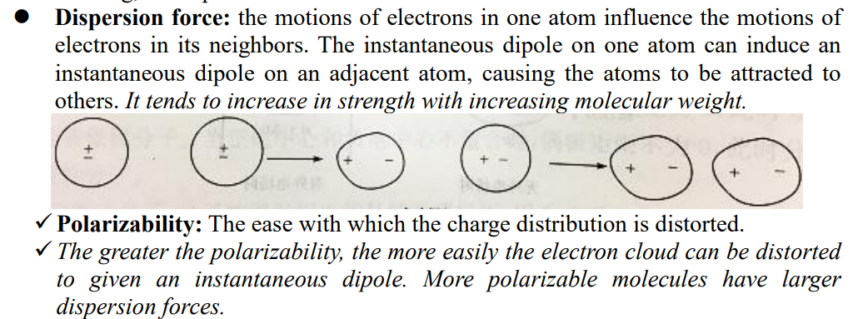
11. Of the following substances, only ________ has London dispersion forces as the only intermolecular force.
A) CH₃OH
B) NH₃
C) H₂S
D) Kr
E) HCl
D
Dispersion force, Dipole-dipole force, Hydrogen bonding
Dispersion force, Dipole-dipole force, Hydrogen bonding
Dispersion force, Dipole-dipole force
Dispersion force
Dispersion force, Dipole-dipole force

Slide 13
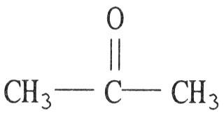
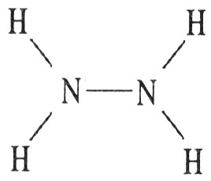

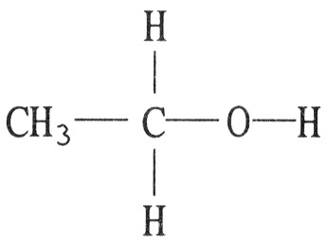
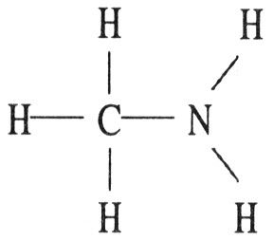
12. Which one of the following substances will not have hydrogen bonding as one of its intermolecular forces? ________
A) D)
B)
C) E)
A

Slide 14
13. Which statements about viscosity are true? ________
(i) Viscosity increases as temperature decreases.
(ii) Viscosity increases as molecular weight increases.
(iii) Viscosity increases as intermolecular forces increase.
A) (i) only
B) (ii) and (iii)
C) (i) and (iii)
D) none
E) all
E

Slide 15
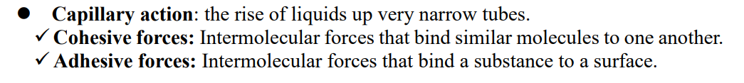
14. How high a liquid will rise up a narrow tube as a result of capillary action depends on ________.
A) the magnitudes of cohesive forces in the liquid and adhesive forces between the liquid and the tube, and gravity
B) gravity alone
C) only the magnitude of adhesive forces between the liquid and the tube
D) the viscosity of the liquid
E) only the magnitude of cohesive forces in the liquid
A

Slide 16
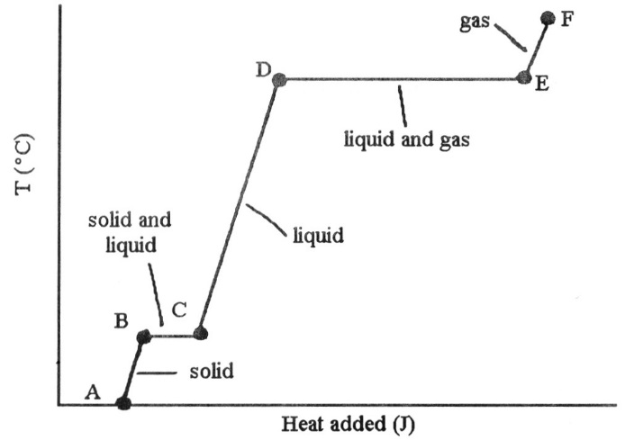
15. The heating curve shown was generated by measuring the heat flow and temperature for a solid as it was heated. The slope of the ________ segment corresponds to the heat capacity of the liquid of the substance.
A) AB
B) BC
C) CD
D) DE
E) EF
C

Slide 17
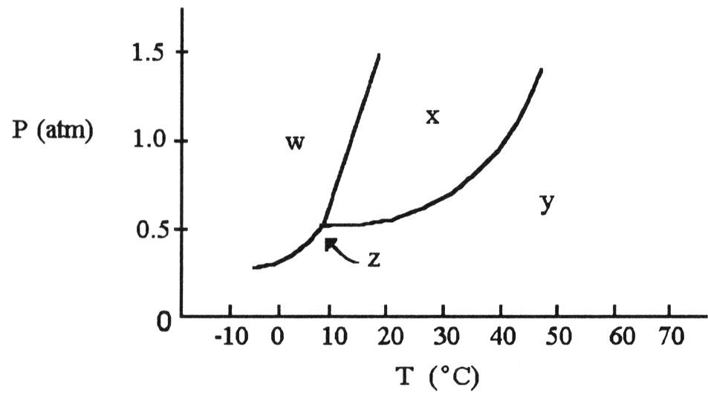
16. The phase diagram of a substance is given. This substance is a ________ at 30 °C and 0.5 atm.
A) liquid
B) gas
C) solid
D) supercritical fluid
E) crystal
B

Slide 18
17. The heat of fusion of water is 6.01 kJ/mol. The heat capacity of liquid water is 75.3 J/mol∙K. The conversion of 50.0 g of ice at 0.00 °C to liquid water at 0.00°C requires ________ kJ of heat.
A) 6.01
B) 16.7
C) 75.3
D) 17.2
E) Insufficient data are given.
B
n = 50 /18 = 2.8 mol
6.01 kJ/mol 75.3 J/mol·K
Water (solid) Water (liquid) Water (gas)
2.8 * 6.01 = 16.7 kg heat

Slide 19
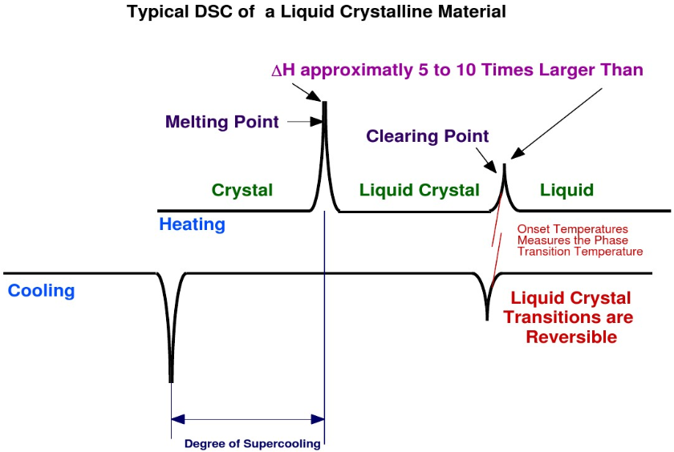
18. For a given substance that exhibits liquid-crystalline properties, the transition from solid to liquid-crystal state occurs ________.
A) over a range of temperatures between the melting point of the solid and the boiling point of the liquid
B) at the melting point of the solid
C) over a range of temperatures that includes the melting point of the solid
D) at a well-defined temperature above the melting point of the solid
E) at a well-defined temperature below the melting point of the solid
B

